Slide 1
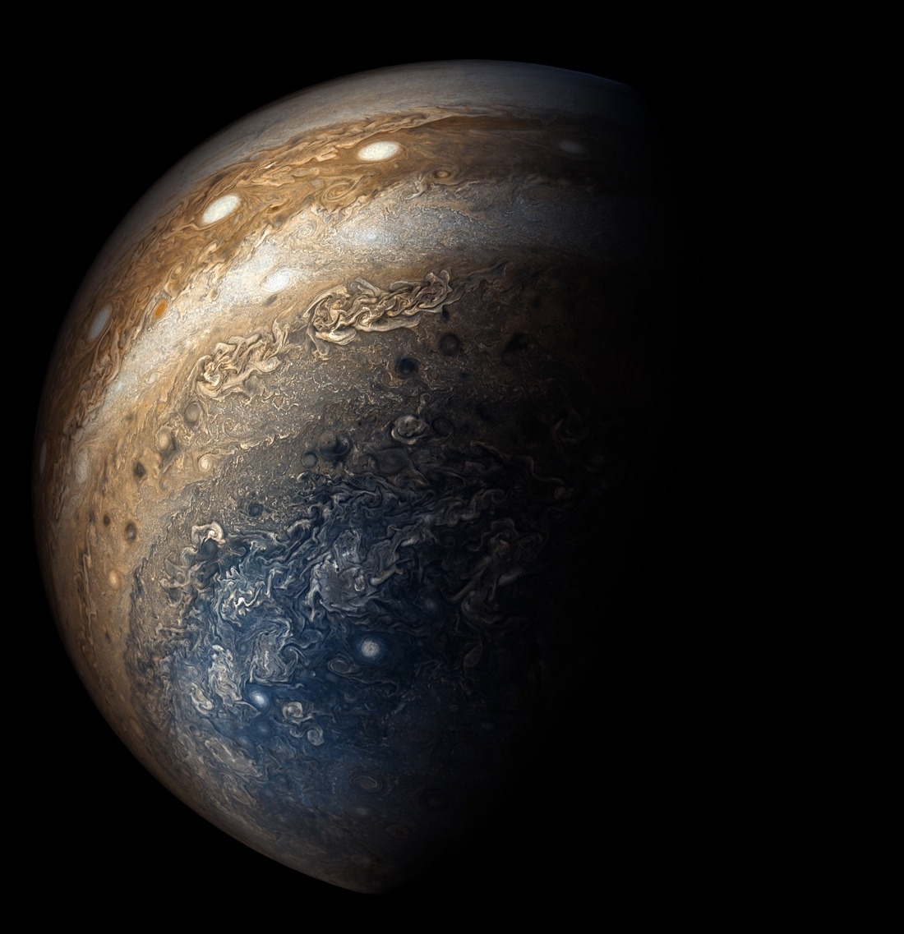
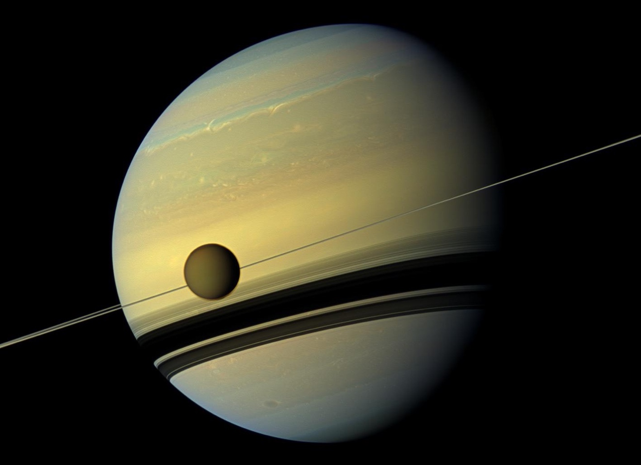
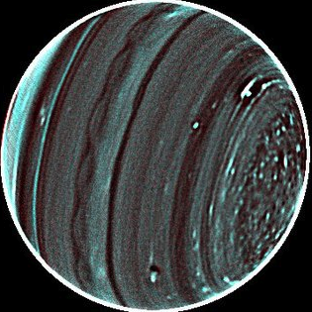

SPICA Planetary Atmospheres
Giant Planets and Titan
Leigh Fletcher, Conor Nixon, Davide Grassi, Glenn Orton, Hideo Sagawa, Emmanuel Lellouch, Matt Griffin
DPS48/EPSC11 #501.08

Slide 2
Space Infrared Telescope for Cosmology and Astrophysics (SPICA)
JAXA/ESA 2032 launch (M5 mission, Phase A from 2019-2021)
Cryogenic Telescope: Ritchey-Chretien 2.5-m primary; V-groove radiators and cryocoolers to maintain below 8 K.
Orbit: Halo orbit around L2.
Spectral coverage: 12-230 µm
SMI (SPICA Mid-infrared Instrument): 12-36 μm
SMI-LRS (Low-Resolution Spectroscopy): 17–36 μm
SMI-MRS (Mid-Resolution Spectroscopy): 18–36 μm, R=2,000
SMI-HRS (High-Resolution Spectroscopy): 9.6–18 μm, R=29,000 (Updated, March 2020)
SAFARI (SPICA Far-infrared Instrument): 34–210 μm

Slide 3
Potential for Giant Planet/Titan Science
SMI/HRS:
Range is 9.6-18 microns (1050 – 560 cm-1), with R = 29,000 and slit area 4” x 1.7” = 6.8 sq. arcsec.
Assume that the saturation limit corresponds to the product of the slit area and the planet disk-averaged surface brightness.
HRS saturation level 20,000 Jy. For Jupiter (diameter ~40”; TB » 130 K), the captured flux density is < 2 kJy at all wavelengths, so well within saturation limit (confirmed by H. Kaneda).
Saturn (diameter ~20”), Uranus (diameter ~3.6”) and Neptune (diameter ~2.2”) all less bright and so observable over the whole HRS range.
SMI/MRS:
Range is 18-36 µm (278 – 560 cm-1) with R = 1300-2300 and slit area is 60” x 3.7”.
Jupiter and Saturn fall within the slit length but are much larger than the slit width.
Uranus and Neptune both fall within the slit.
MRS saturation at 1000 Jy. Jupiter will probably cause saturation (confirmed as “borderline” by H. Kaneda, and MRS saturation is likely to worsen as sensitivity improves in future); Saturn may be OK, and there will be no problem with saturation for Uranus and Neptune.
SAFARI
Assume that Mars, Jupiter, Saturn, Uranus and Neptune will not be observable due to detector saturation.

Slide 4
Key Motivation
Planning ~70 hours of time
Exploring Planetary Atmospheres as Chemical Laboratories
Exceptional spectral resolution will enable the exploration of complex stratospheric chemistry within the myriad different environments of the outer solar system, including:
Hydrogen- and nitrogen-rich atmospheres (e.g., Saturn versus Titan),
Well-mixed or sluggish atmospheres (Neptune versus Uranus), and
Investigate the influence of externally-supplied oxygen to their upper atmospheres.
Why not JWST? Or Cassini?
It doesn't have the spectral resolution to probe the forest of fine emission features in the mid-infrared, to search for the undiscovered chemical species that link the chemical networks.
No current/future mission to these destinations (Juno, JUICE) has this capability.
Why not from the ground?
HRS probing a spectral region that we cannot see from Earth in the 13-17 µm range (e.g., CO₂ at 15 µm).
MRS probing a region beyond 24 µm that cannot be viewed from the ground (due to H₂O).

Slide 5
Spatial Resolution Capabilities
Like Spitzer, we would acquire disc-integrated spectroscopy of Uranus, Neptune, and Titan as the objects rotate:
Longitudinal variability in emission.
Use of temperature/hydrocarbon/nitrile distributions to determine the strength of atmospheric mixing.
Search for previously-unidentified species (and isotopologues) within these “chemical laboratories.”
Understand the influence of external sources (HCN, CO2) on chemical pathways.
For Jupiter/Saturn: can we scan the 4” x 1.7” HRS slit and 60”x3.7” MRS slit across the target for crude spectroscopic mapping?
H. Kaneda: The beam steering mirror (BSM) can be used for both MR and HR. Movement is perpendicular to the slit ±30”.
Short telescope maneuvers would be needed in the direction parallel to the slit for HRS (slit is 4”).
For MRS, the whole area could be covered (60” slit and ±30” BSM).

Slide 6
Access to Mid-IR Molecular Features
SMI/HRS 9.6-18 µm (1050 – 560 cm-1), with R = 29,000:
Stratospheric thermometers: H₂(S1) @587 cm⁻¹ (17 µm) and H₂(S2) @814 cm⁻¹ (12.3 µm).
Tropospheric temperatures from H2-He collision-induced continuum.
Primary hydrocarbons C₂H₂ (acetylene n₅ @729 cm⁻¹) and C₂H₆ (ethane n₉ @822 cm⁻¹) in addition to C3H8 (propane n26 @748 cm-1); C4H2 (diacetylene n8 @628 cm-1); C3H4 (methylacetylene n9 @633 cm-1); C6H6 (benzene n4 @664 cm-1); C₂H₄ (ethylene, n7 @949 cm⁻¹)
Externally sourced materials (HCN n2 @712 cm-1, CO2 n2 @ 667 cm-1 and isotopes)
Tropospheric ammonia (NH₃, n2 @950 cm-1) and phosphine (PH₃, n2 @992 cm-1)
Titan nitriles HCN n2 @712 cm-1, HC3N n5 @663 cm-1, HC5N.
Isotopic separation of HCN, HC₃N, C₂H₂, C₄H₂, C₂H₆, C₂H₄, CH₄, CO₂
SMI/MRS 18-36 µm (278 – 560 cm-1) with R = 1300-2300:
Collision-induced continuum for tropospheric temperature (and thermal windshear); ortho/para-H2; maybe helium.
C2H6 n4 @289 cm-1; C3H4 n10 @328 cm-1; HC3N n6 @499 cm-1.
Stratospheric thermometer H₂(S0) @354 cm⁻¹ (28 µm) and surrounding dimers.
HD R(3) rotational line @350 cm-1.

Slide 7
Upscopes: < 9.6 µm?
What if SPICA SMI could go to shorter wavelengths, down to 7 µm?
Kaneda: The shorter wavelength end cannot go under 9 microns in theory, because of the octave limitation of the grating. This is a trade-off between the wavelength coverage and sampling frequency.
CH4 n4 @1304 cm-1 for stratospheric temperatures.
CH3D n6 @1156 cm-1 for D/H ratio
From Hideo: Martian O3 @9.6 µm, provided it’s below saturation and a useful complement to things like TGO.

Slide 8
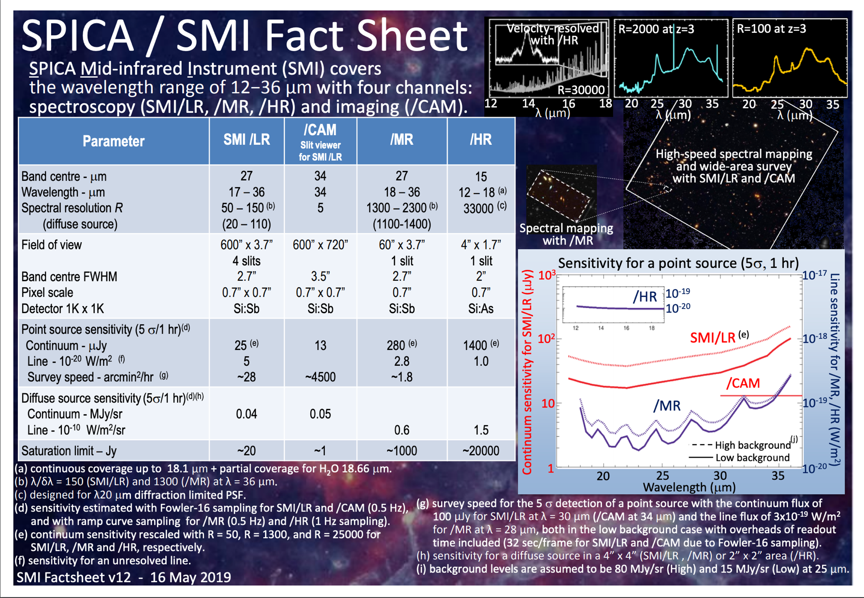

Slide 9
Spectral Simulations with NEMESIS
Giant Planets (L.N. Fletcher):
Forward model uses mid-IR line data sources and profiles approved by Cassini/Spitzer teams (i.e., heritage).
Line-by-line calculations at 45 degree emission angle as a crude approximation of the disc-average.
Some missing gases in the model still (work in progress).
Titan (C. Nixon):
Temperature and gas profile are equatorial profiles derived from Cassini CIRS (Teanby et al. 2007, Vinatier et al. 2008a).
Potential Future Updates:
Switch from 45-deg emission to disk-averaged using 10 emission angles.

Slide 10
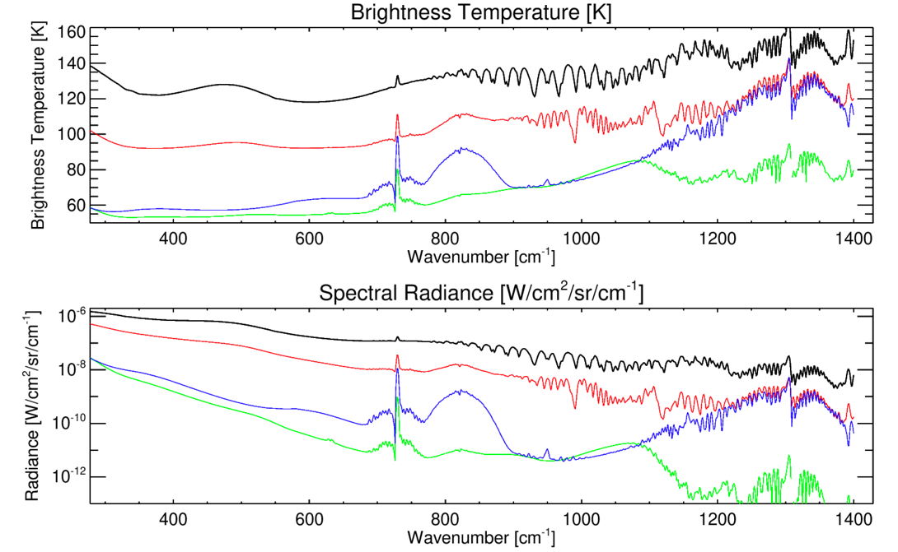
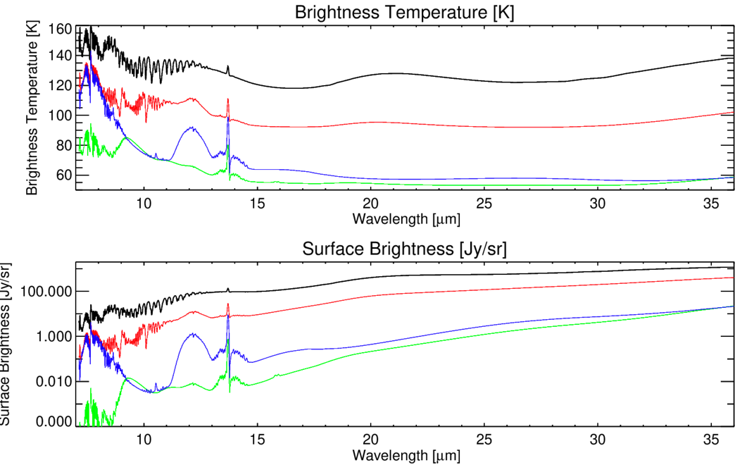
Giant Planet Overview Spectra
[Jy/arcsec²]
[Jy/arcsec²]
NEMESIS forward models at 2.5 cm-1 spectral resolution.
Jupiter (black), Saturn (red), Uranus (green), Neptune (blue).
Missing higher-order hydrocarbon features.
Demonstrate locations of key features and extensions to 7 µm.
Calculated for 45º emission angle viewing, single path (i.e., no disc integration).

Slide 11
SPICA SMI/HRS (9.6-18 µm)

Slide 12
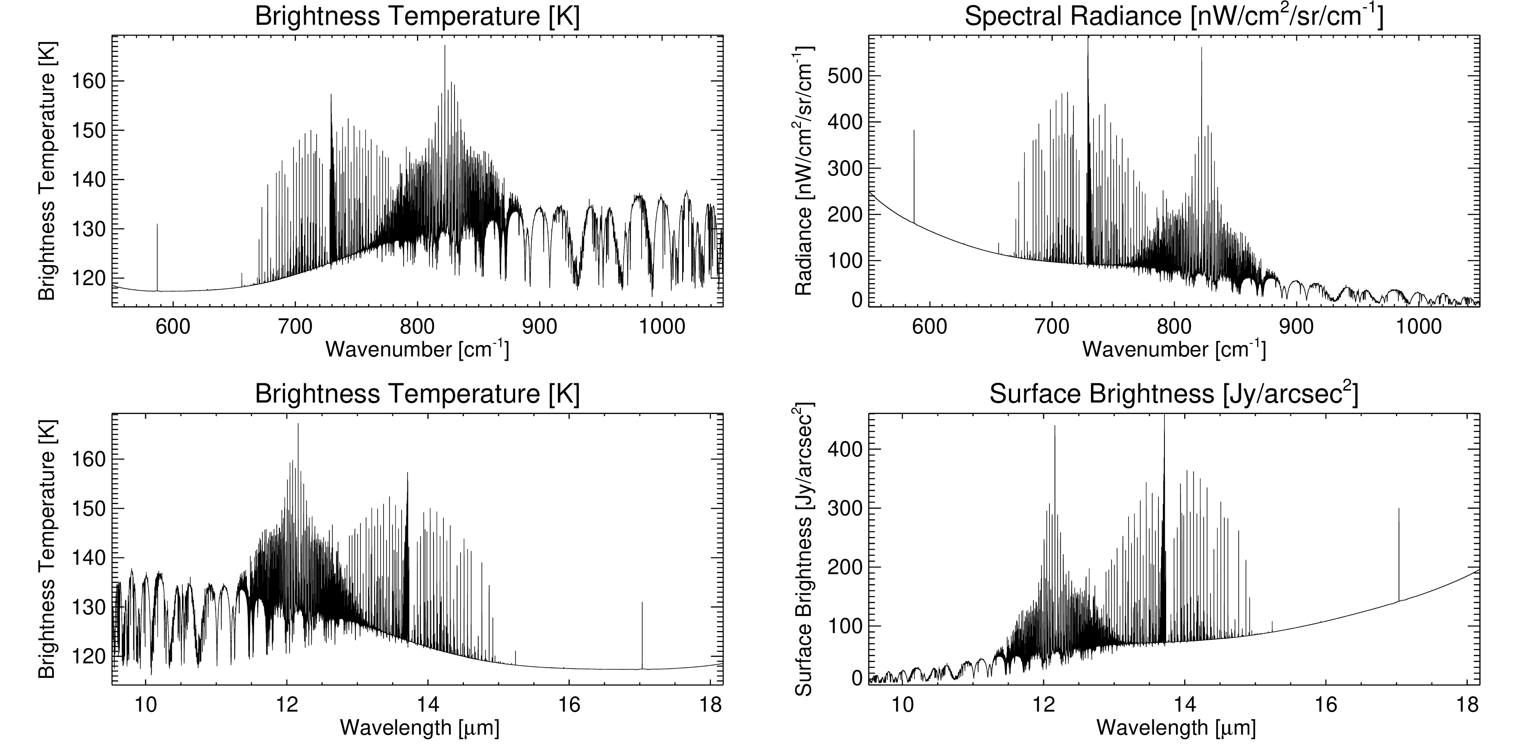
Jupiter SMI/HRS
Forward model @emm=45º
R=29,000
Line-by-line
Datafiles for download: https://github.com/leighfletcher/SPICA

Slide 13
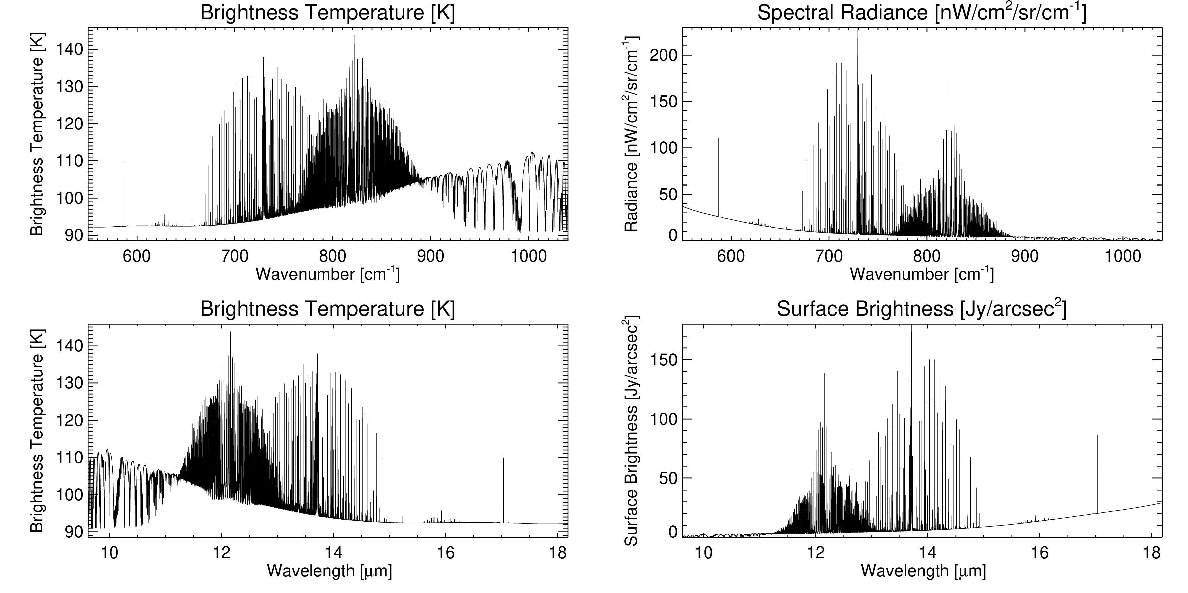
Saturn SMI/HRS
Forward model @emm=45º
R=29,000
Line-by-line
Datafiles for download: https://github.com/leighfletcher/SPICA

Slide 14
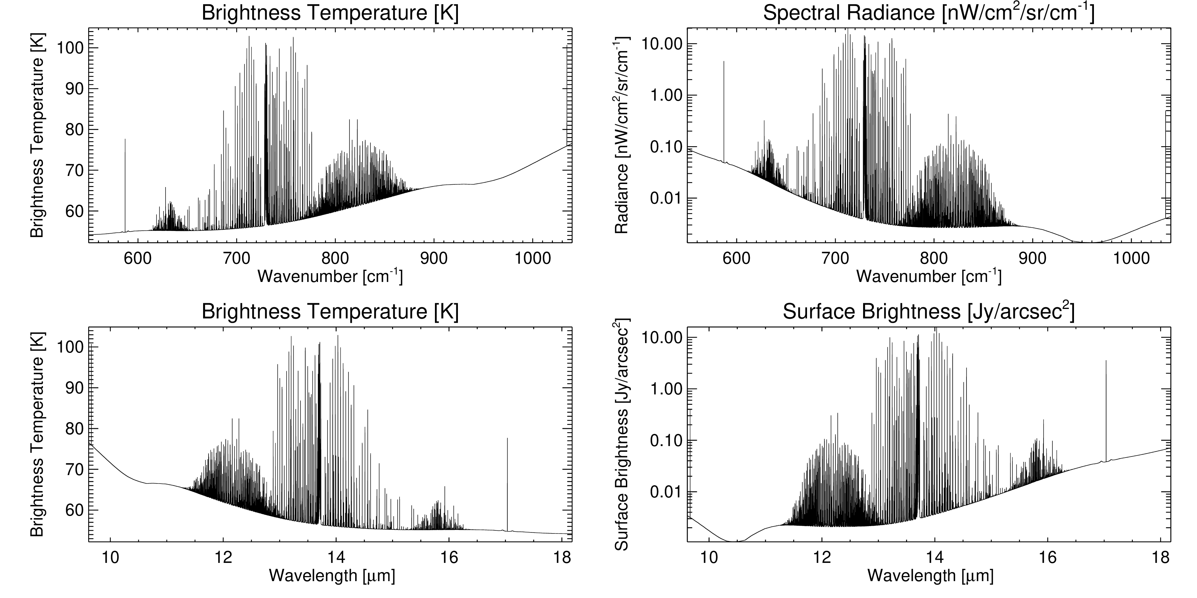
Uranus SMI/HRS
Forward model @emm=45º
R=29,000
Line-by-line
Datafiles for download: https://github.com/leighfletcher/SPICA

Slide 15
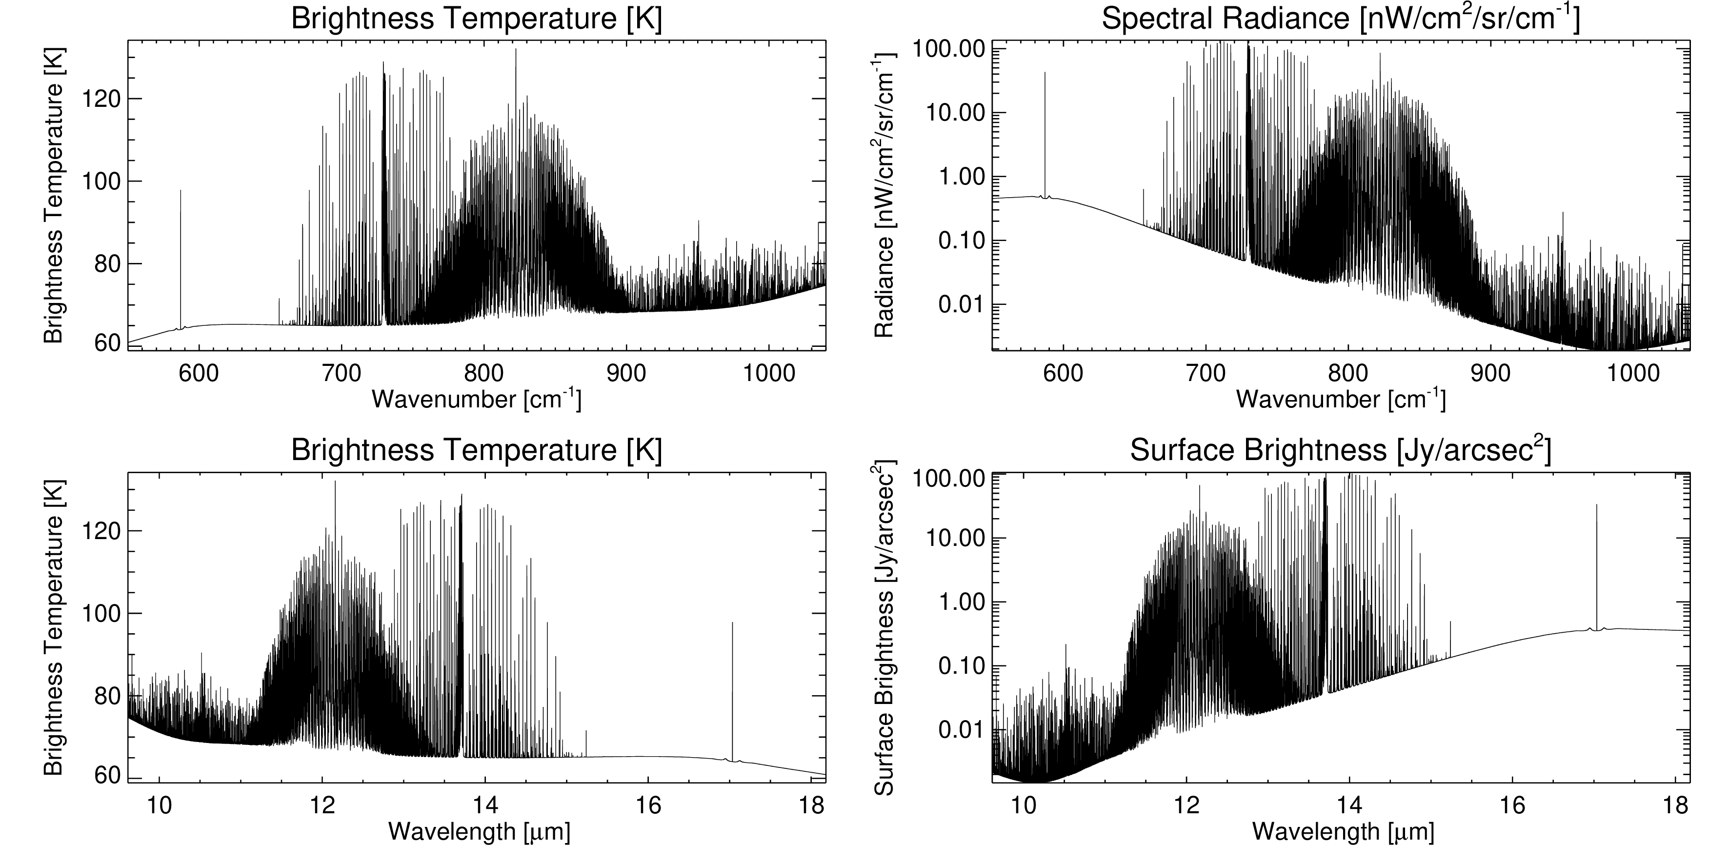
Neptune SMI/HRS
Forward model @emm=45º
R=29,000
Line-by-line
Datafiles for download: https://github.com/leighfletcher/SPICA

Slide 16
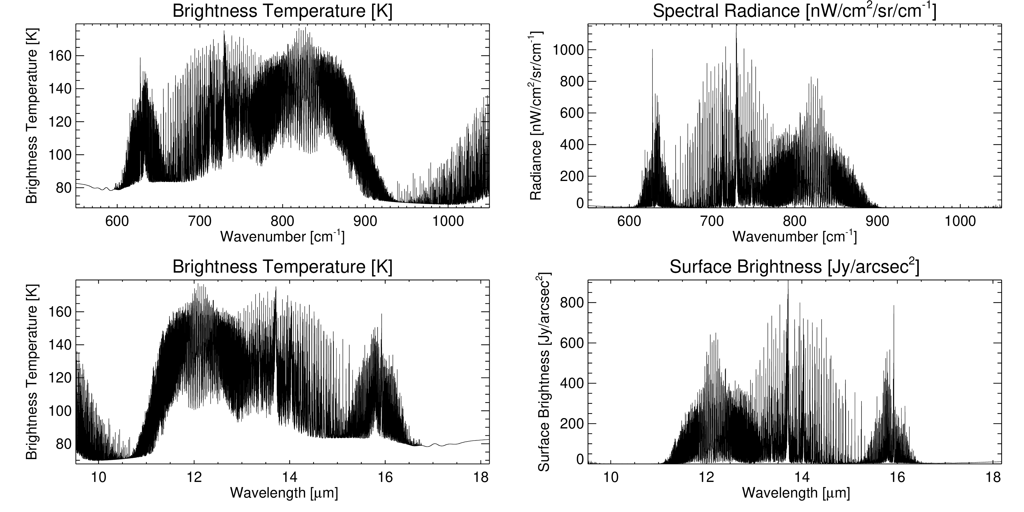
Titan SMI/HRS
Forward model @emm=45º
R=29,000
Line-by-line
Datafiles for download: https://github.com/leighfletcher/SPICA

Slide 17
SPICA SMI/MRS (18-36 µm)

Slide 18
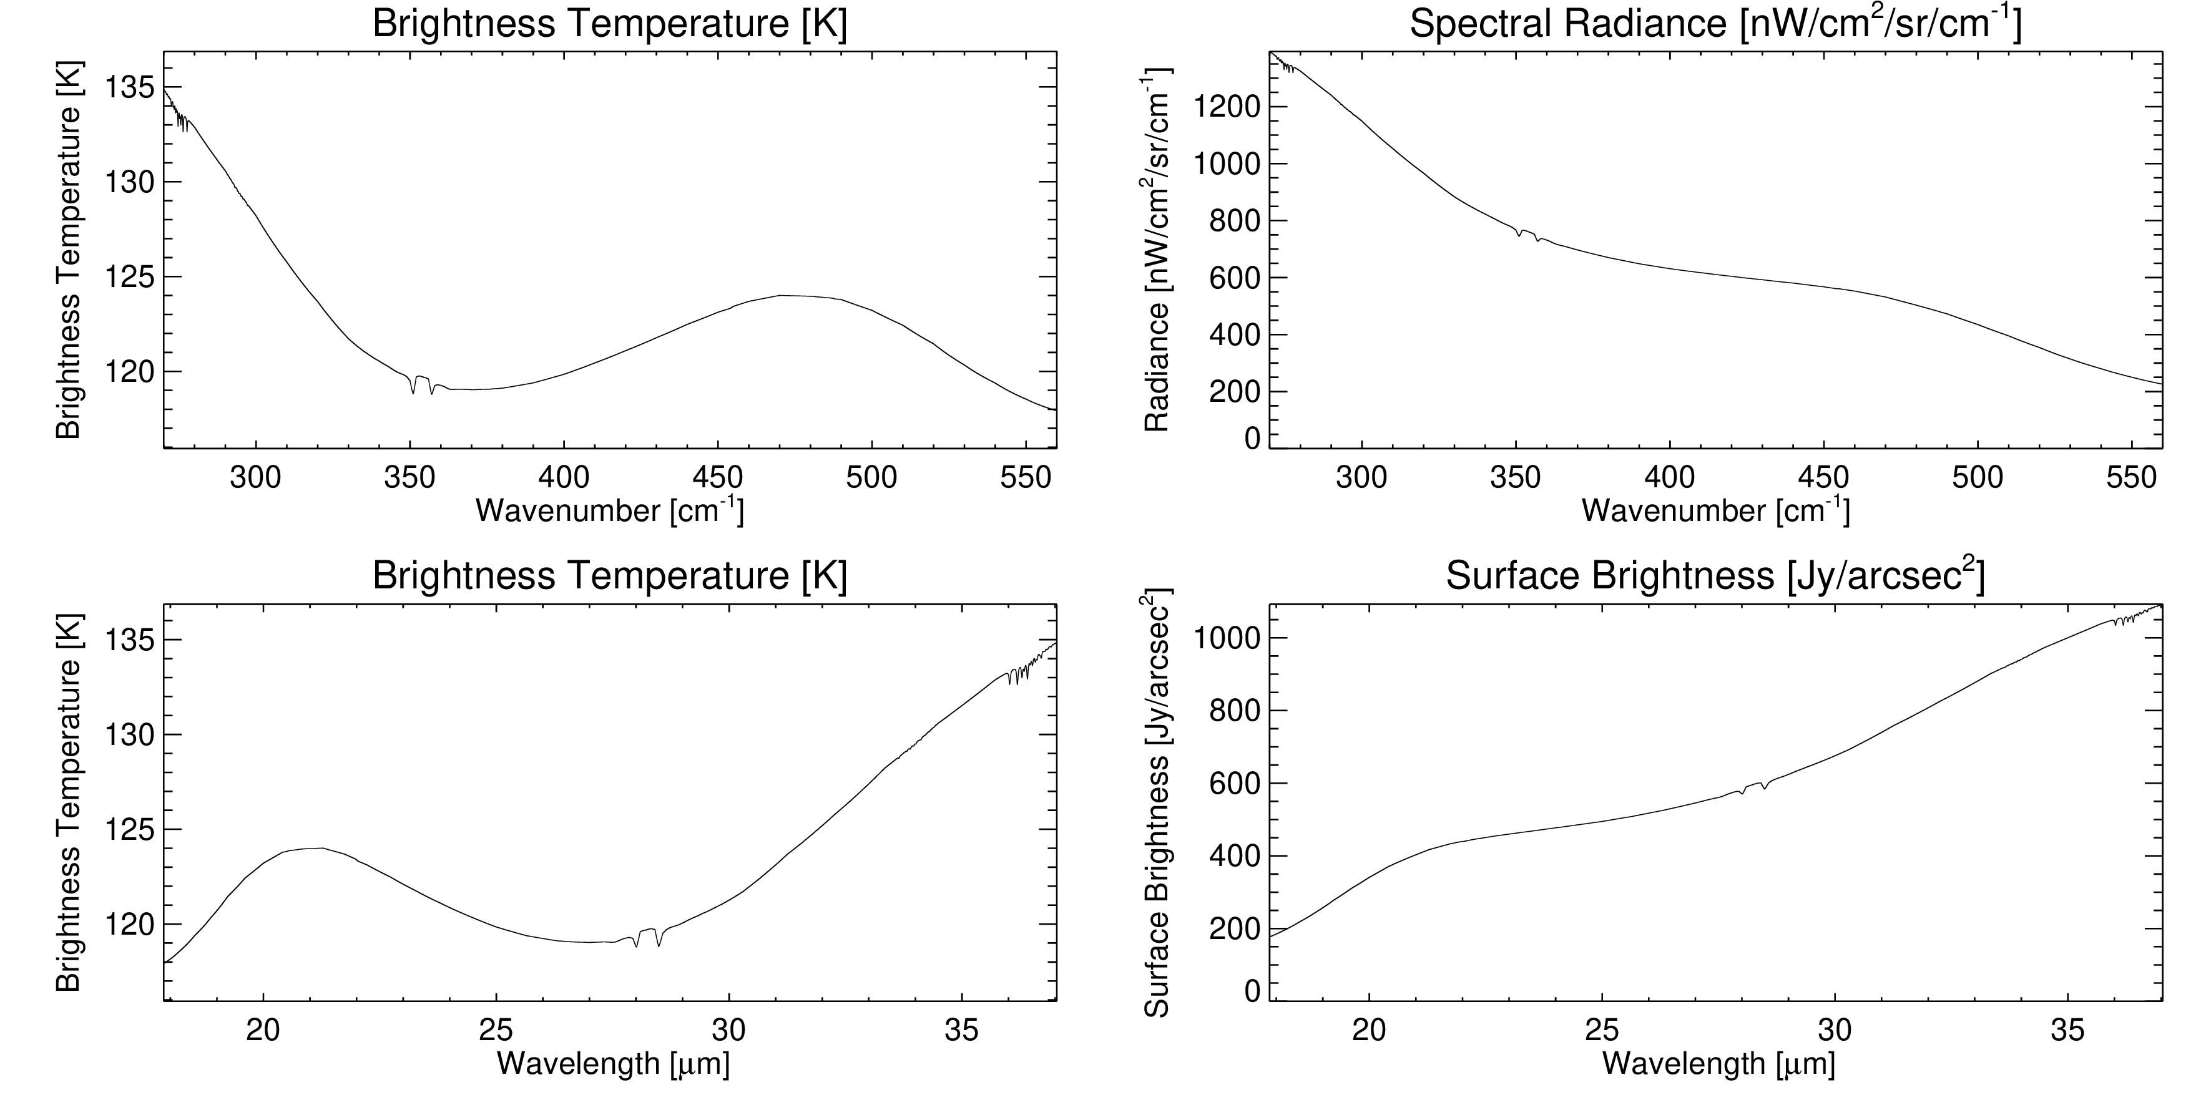
Jupiter SMI/MRS
Forward model @emm=45º
R=2,300
Line-by-line
Datafiles for download: https://github.com/leighfletcher/SPICA

Slide 19
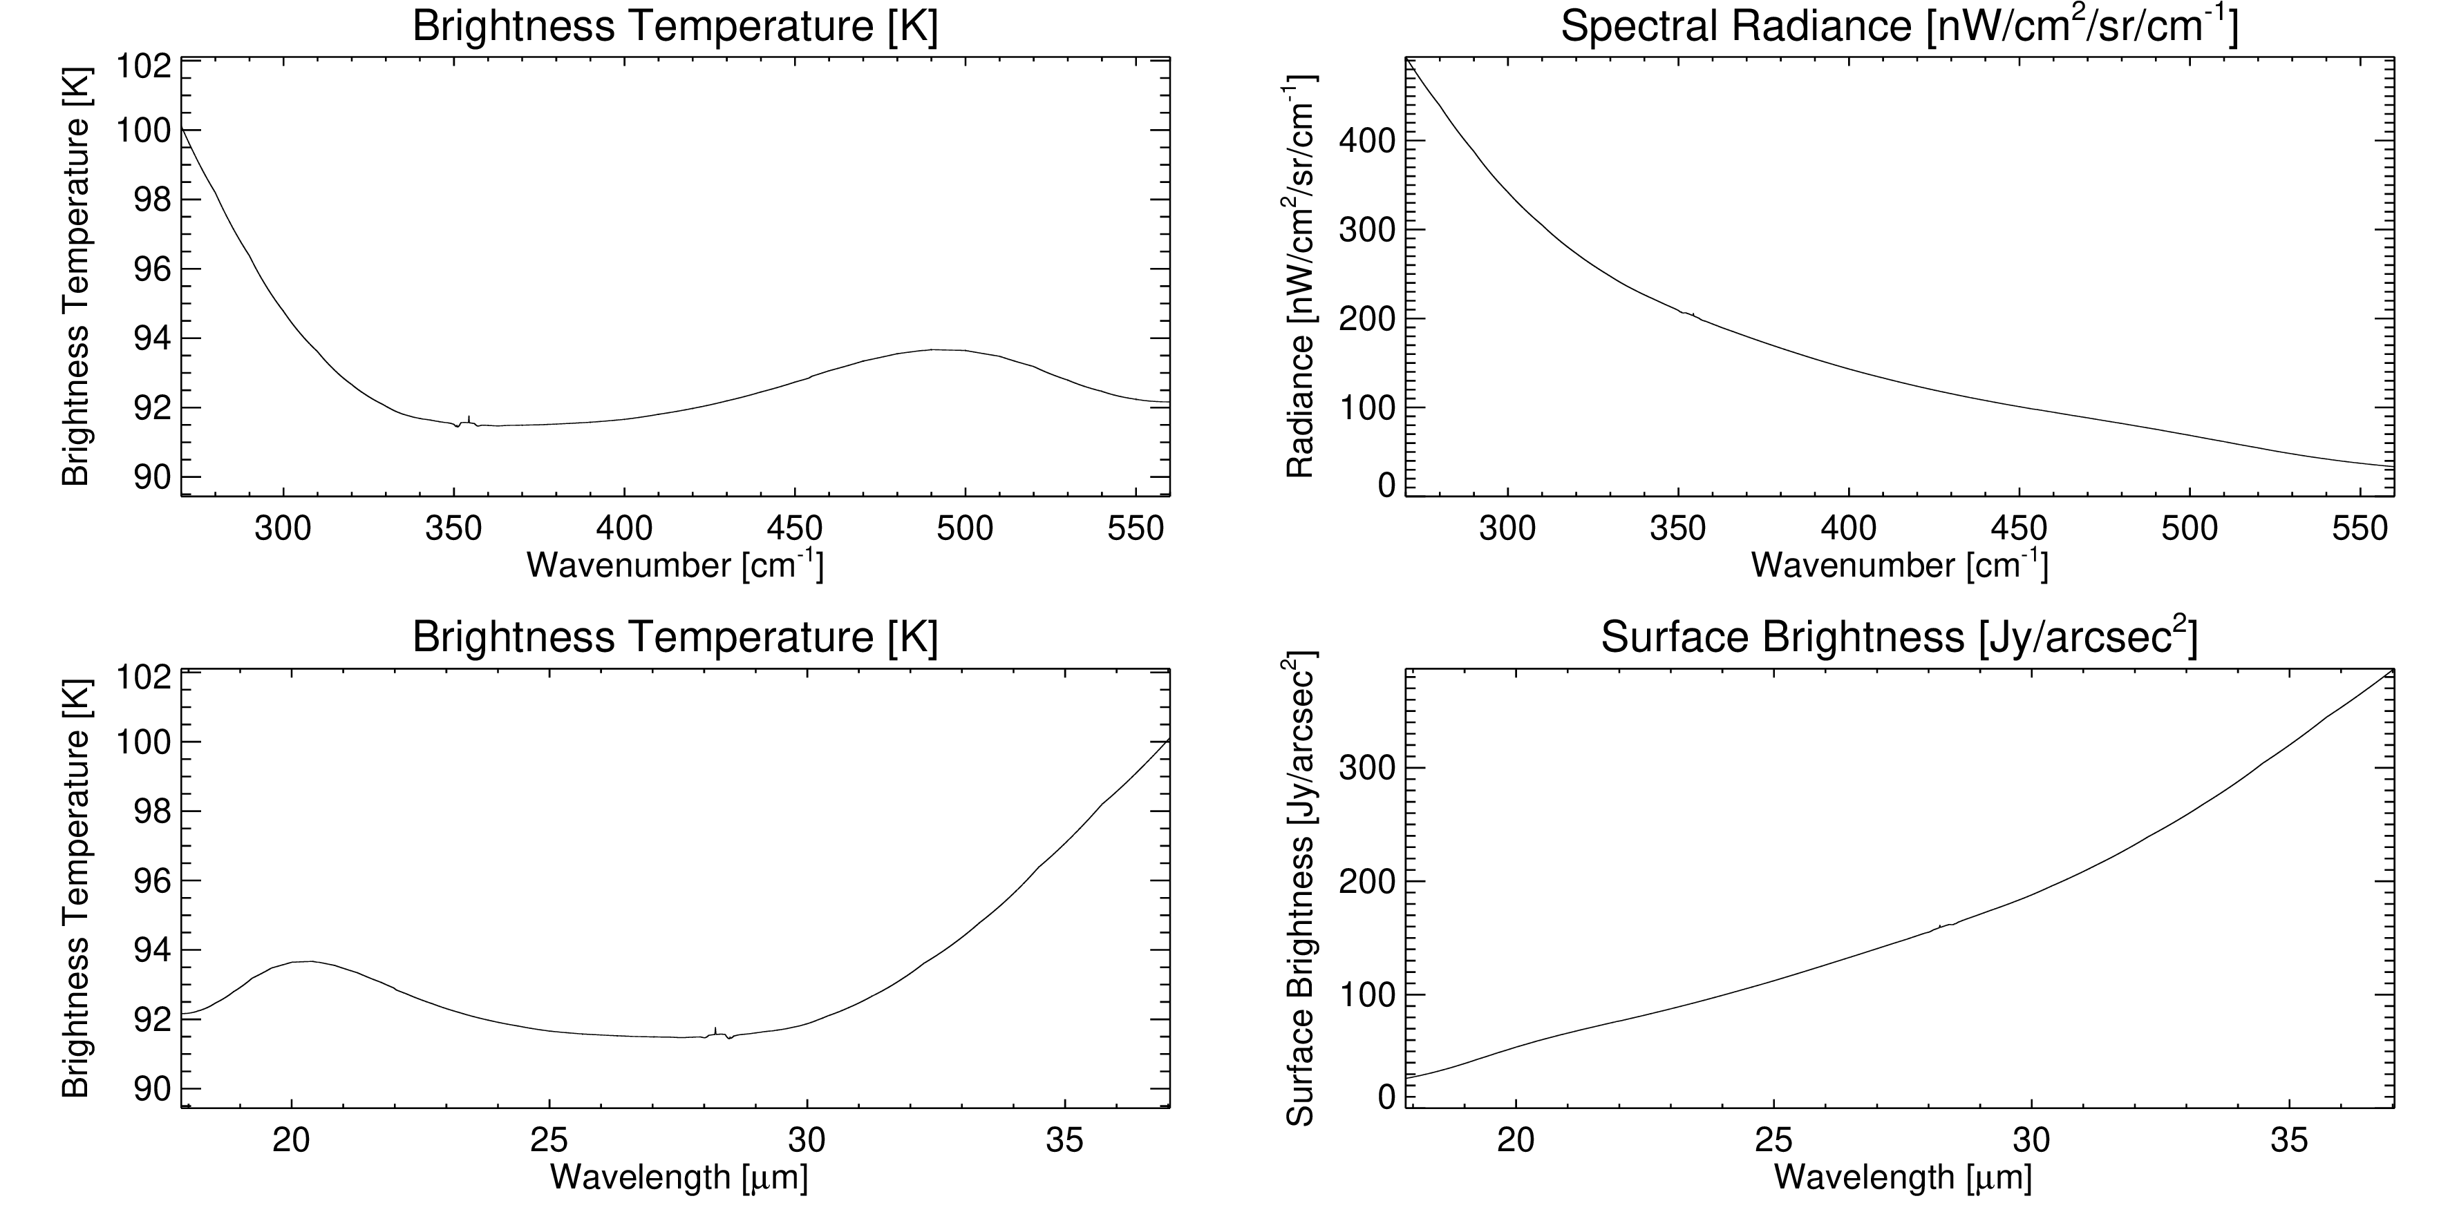
Saturn SMI/MRS
Forward model @emm=45º
R=2,300
Line-by-line
Datafiles for download: https://github.com/leighfletcher/SPICA

Slide 20
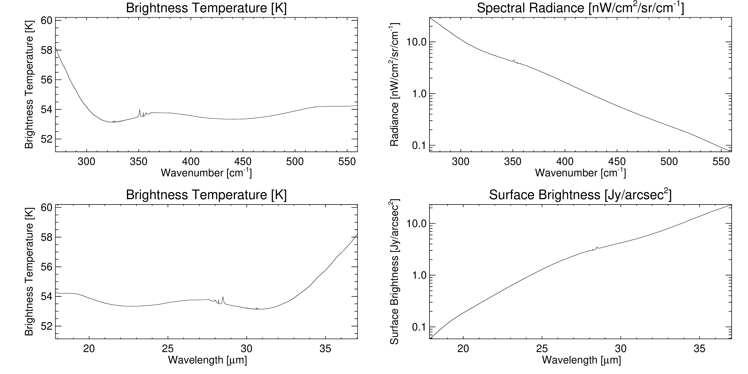
Uranus SMI/MRS
Forward model @emm=45º
R=2,300
Line-by-line
Datafiles for download: https://github.com/leighfletcher/SPICA

Slide 21
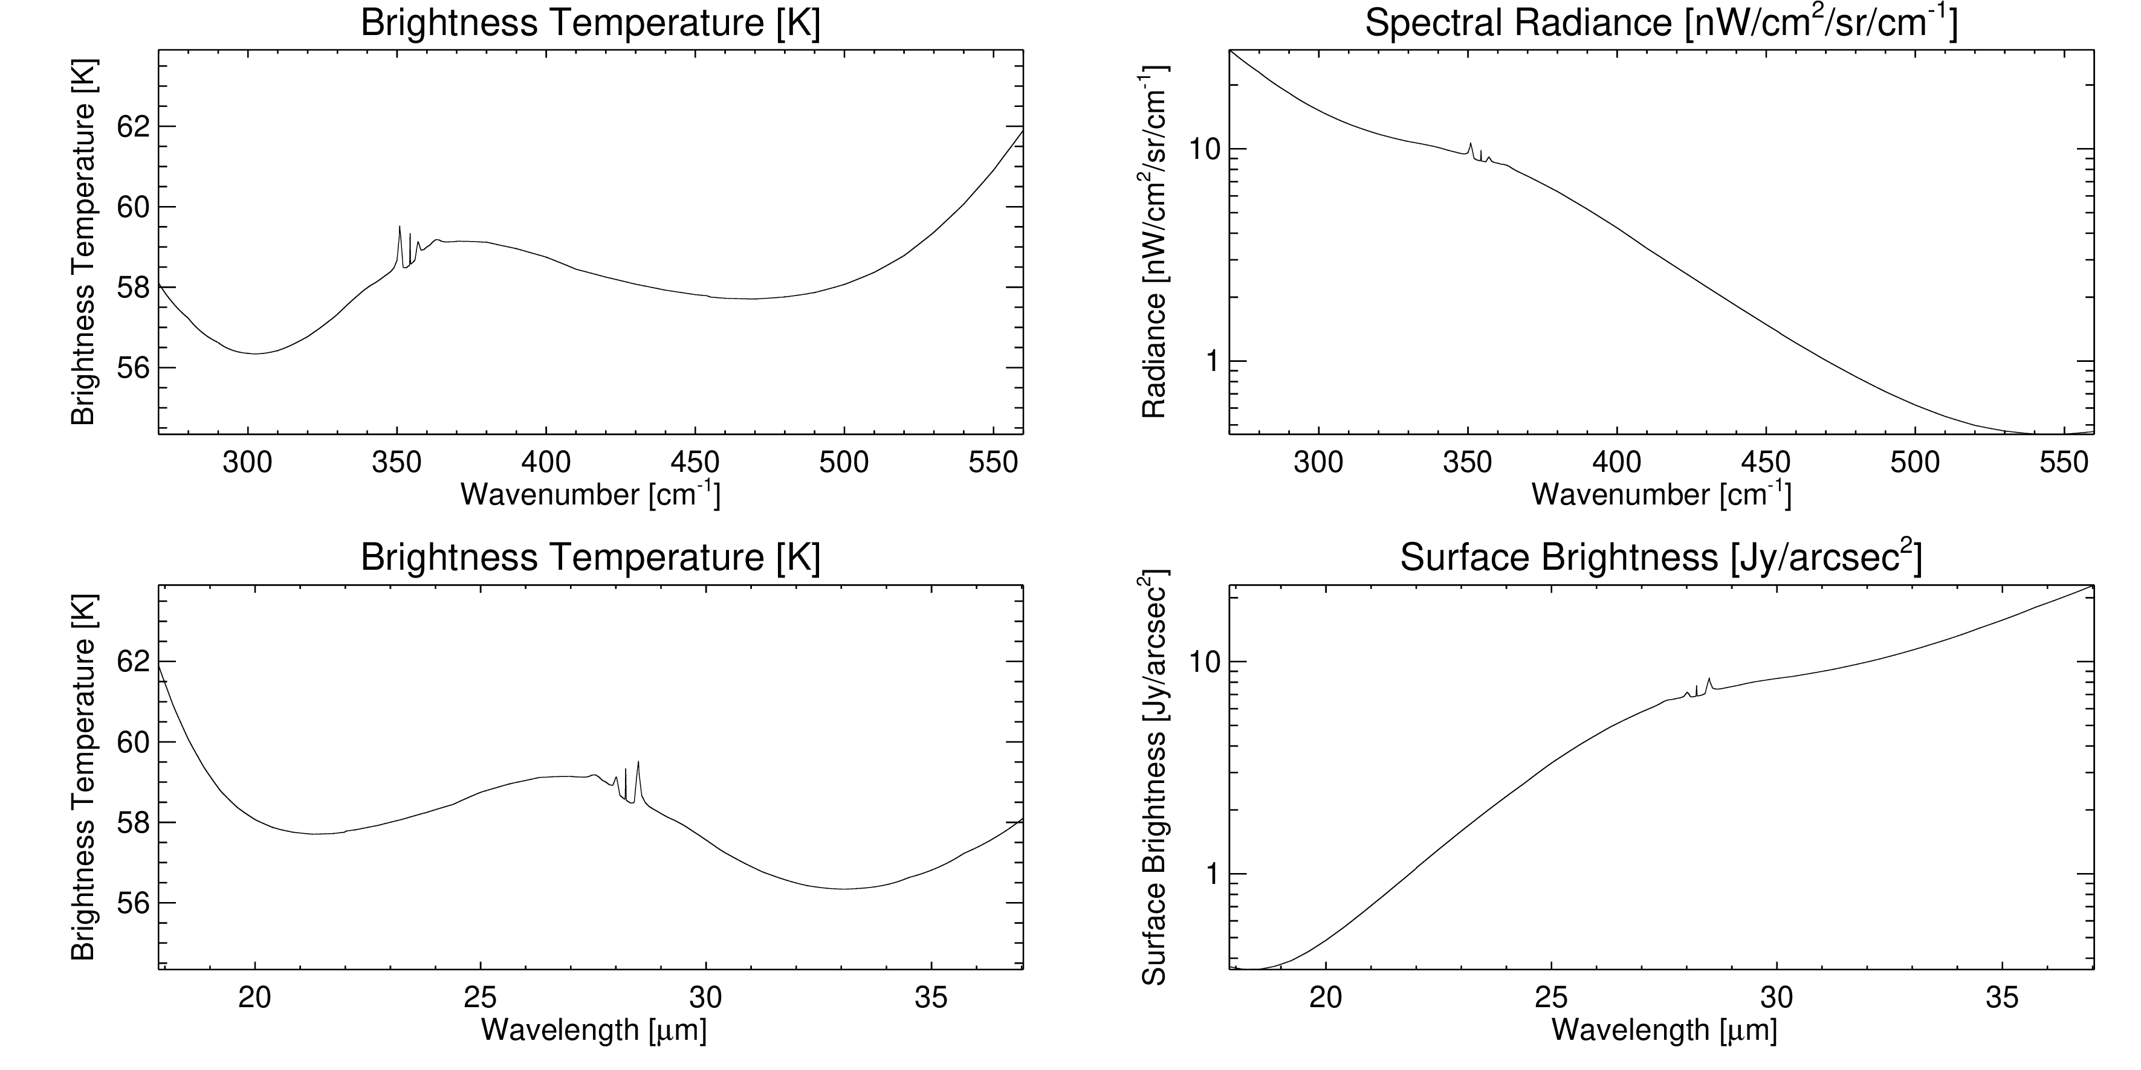
Neptune SMI/MRS
Forward model @emm=45º
R=2,300
Line-by-line
Datafiles for download: https://github.com/leighfletcher/SPICA

Slide 22
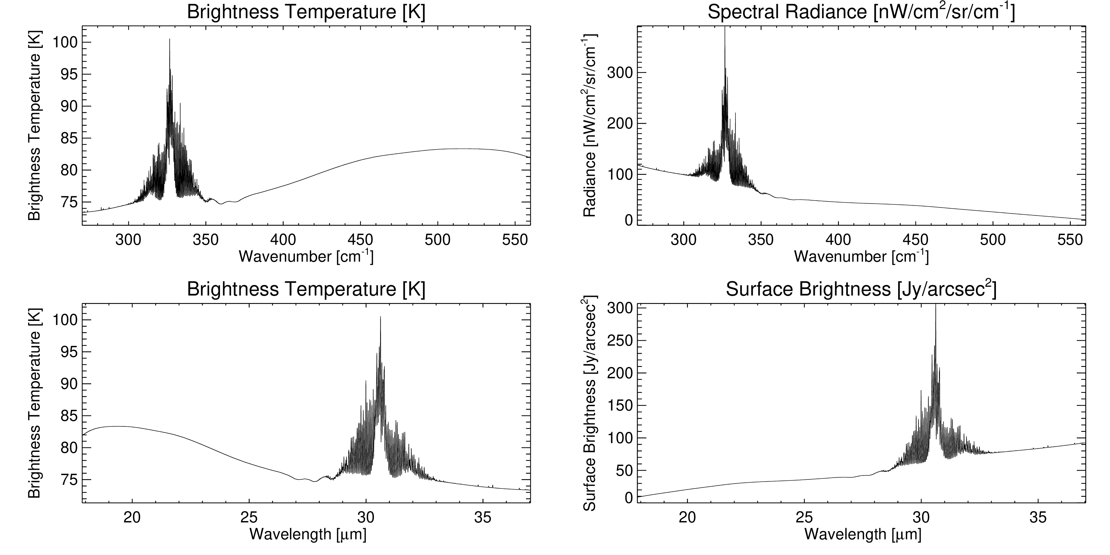
Titan SMI/MRS
Forward model @emm=45º
R=2,300
Line-by-line
Datafiles for download: https://github.com/leighfletcher/SPICA

Slide 23
Work to Do (May 2020)
Enhance spectral simulations of all four giants and Titan in SMI/HRS and SMI/MRS spectral ranges (and SAFARI while we’re at it).
Try varying individual gases and adding exotic species.
Move from 45-degree emission angle to full disc-integration.
Use spectral calculations for sensitivity/saturation study.
Develop the “chemical laboratories” idea into a use-case for the SPICA yellow book [May 2020]
Develop contributions to a Solar System white paper [Q1 2021].

Slide 24
Supplemental Slides

Slide 25
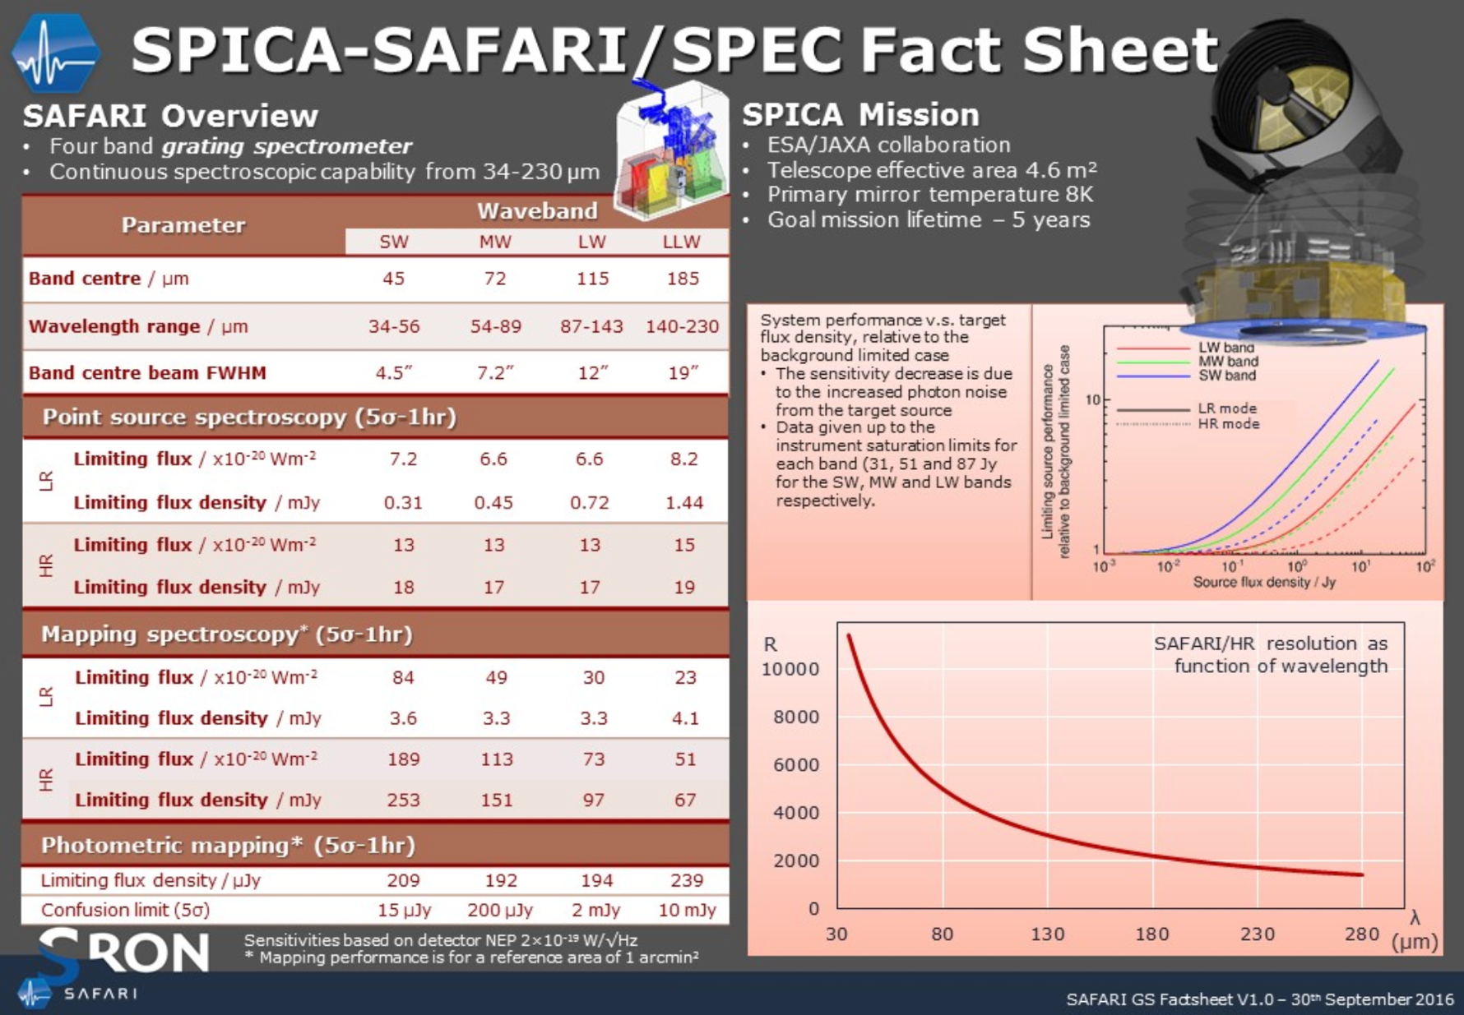

Slide 26
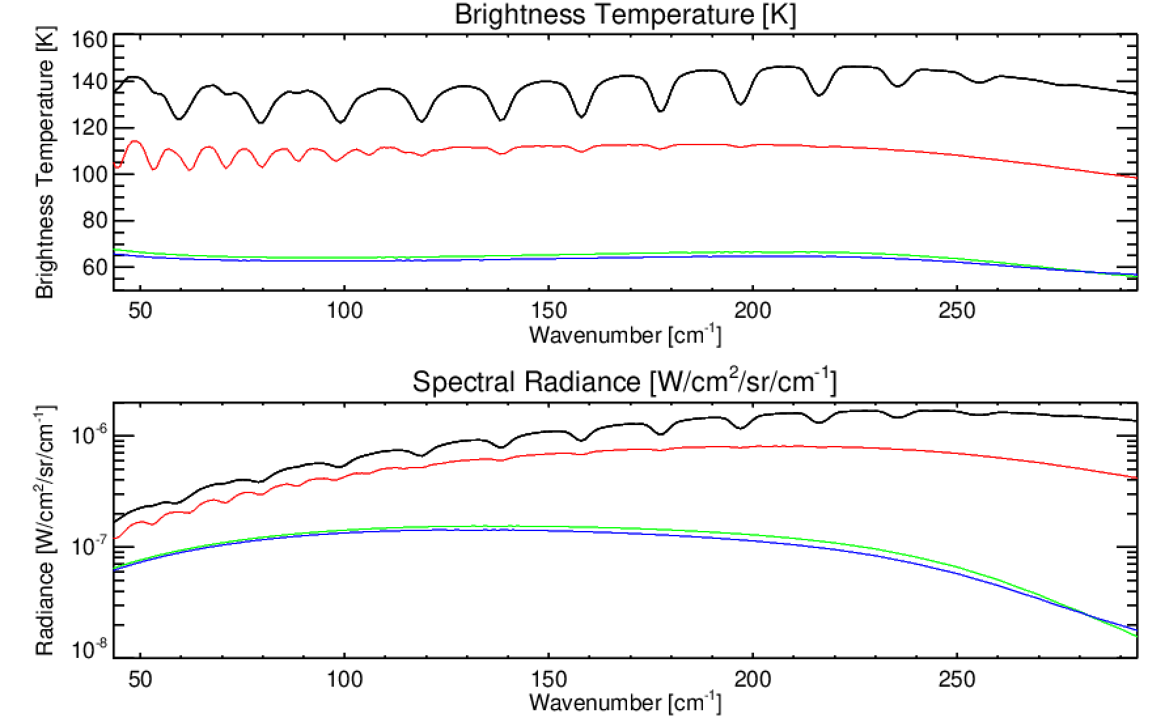
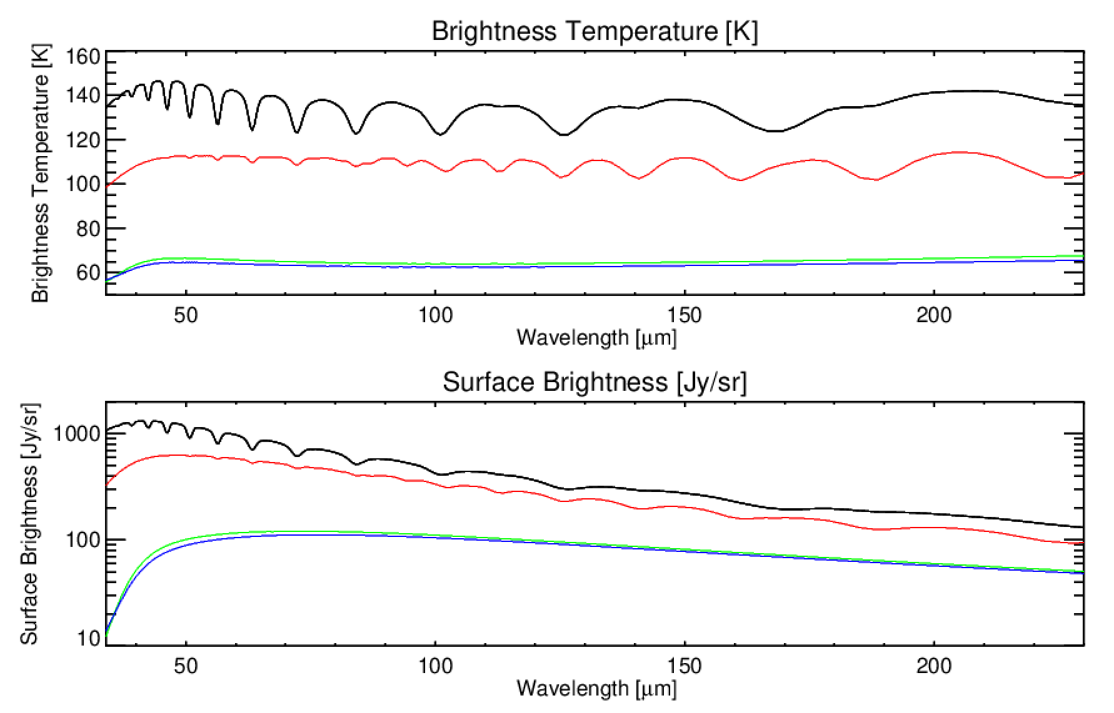
SPICA/SAFARI Calculations
[Jy/arcsec²]
[Jy/arcsec²]
Low-resolution calculation to show continuum brightness (but does not show narrow emission/absorption features).
Ammonia/phosphine lines show up for Jupiter and Saturn (black and red), but not for Uranus and Neptune (green and blue).
2.5 cm-1 resolution used, based on Cassini/CIRS and Spitzer/IRS models.

Slide 27
Giant Planet Opposition in 2032
Jupiter – July 19th 2032 (distance of 4.12 AU, and its disk will measure 46.8 arcsec in diameter, shining at magnitude -2.8).
Saturn – December 24th (distance of 8.03 AU, and its disk will measure 20.7 arcsec in diameter, shining at magnitude -0.5)
Uranus – December 20th (distance of 18.04 AU, and its disk will measure 3.9 arcsec in diameter, shining at magnitude 5.5)
Neptune – October 9th (distance of 28.85 AU, and its disk will measure 2.4 arcsec in diameter, shining at magnitude 7.8)
These are used in the calculations that follow.

Slide 28
Nixon K-Tables: Titan SMI/HRS – 600-700 cm-1
C₄H₂
HCN
C₃H₄
CO₂

Slide 29
Nixon K-Tables: Titan SMI/HRS – C2H2 and HCN
C₂H₂
HCN

Slide 30
Nixon K-Tables: Titan SMI/HRS HCN Isotopes

